Slide 1
Music Encoder/Decoder
1
Presented by: Shane Tracey, Tyler Hong, Musbah Khalaff

Slide 2
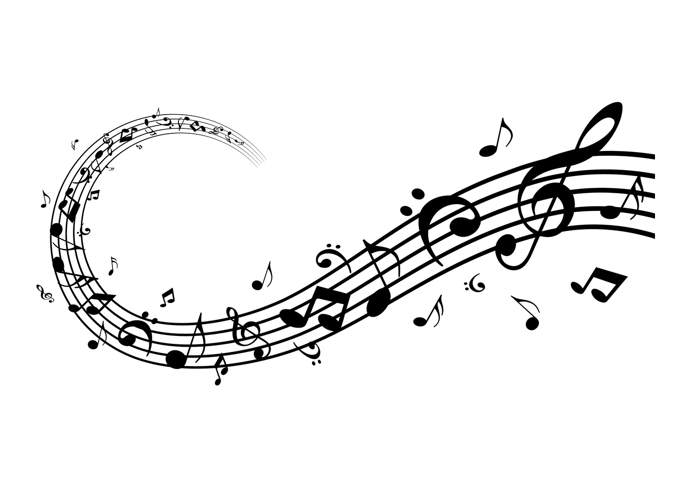
Introduction
2
The main objective of the music encoder/decoder is to encrypt/decrypt messages using music sheets as our medium.
In simpler terms we will be turning words/sentences into playable music sheets and vice versa. After the sentence has been encrypted the music will then be played off the music sheet using piano keys.

Slide 3
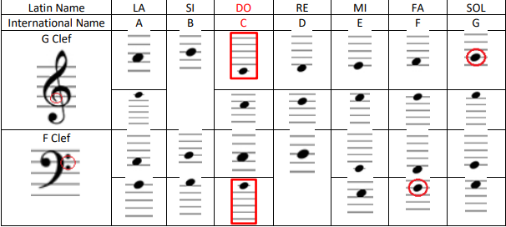
Constraints & Issues
3
The project required us to make the melodies produced have some sort of rhythm to sound good. Without some basic knowledge of music, this posed some difficulties for us. But as time went on and with some help from our supervisors we were provided with a basic understanding of score writing rules. These rules included measures, signatures and rhythms.

Slide 4
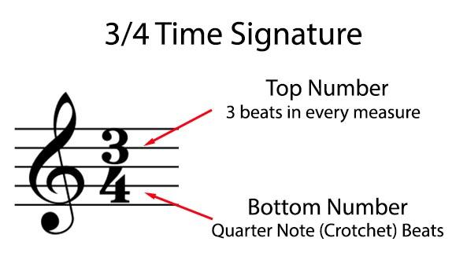
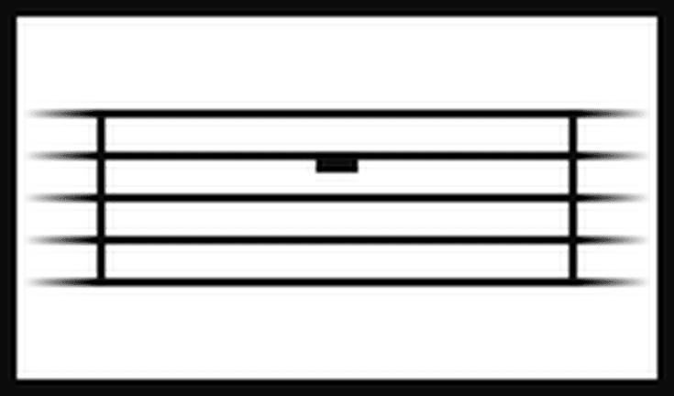
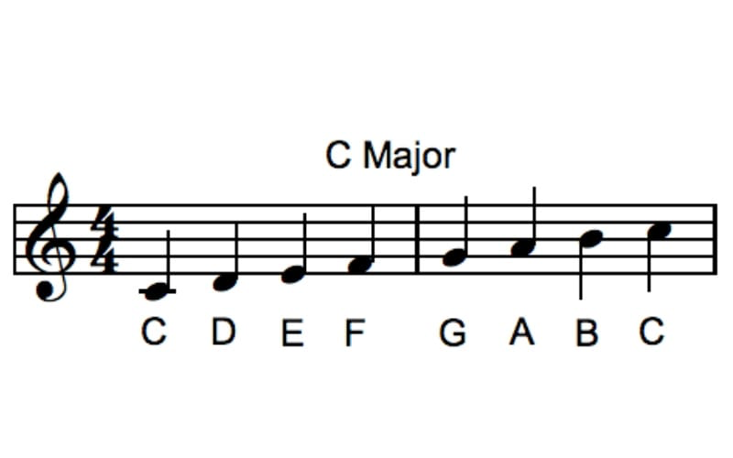
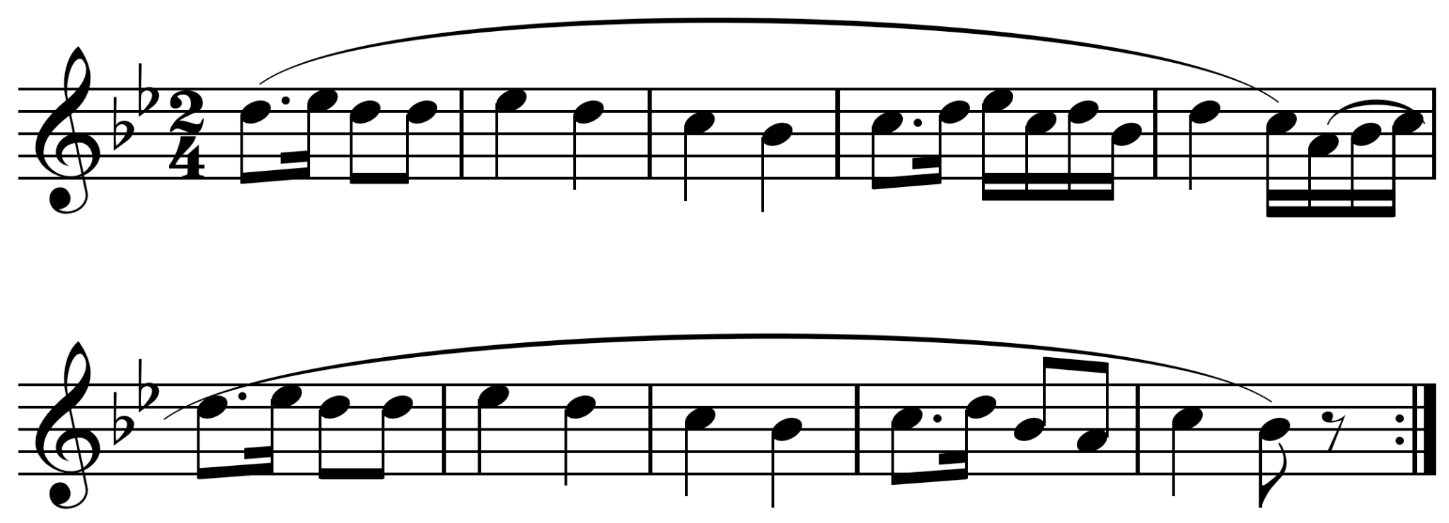
Music Terminology
4
Time Signature and Beat
Measure
Scale
Melody

Slide 5
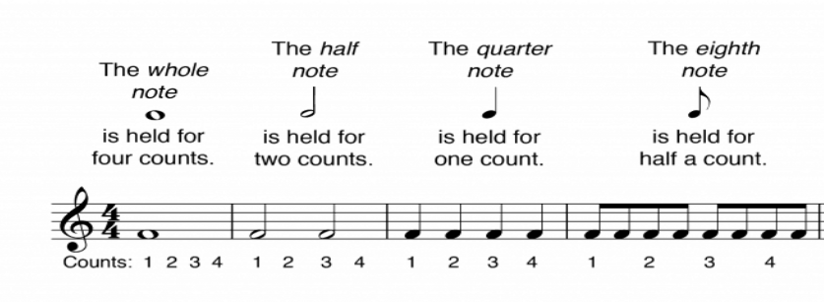
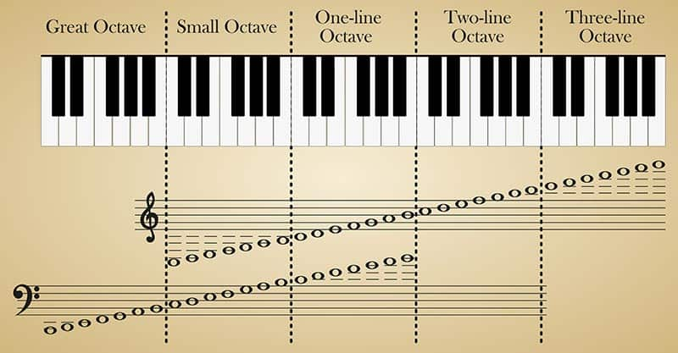
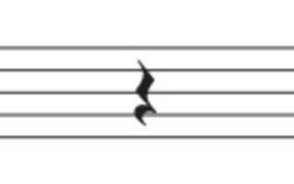
Music Terminology pt.2
5
Rhythm
Phrase
Octave
Rest

Slide 6
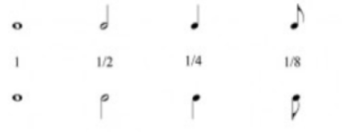
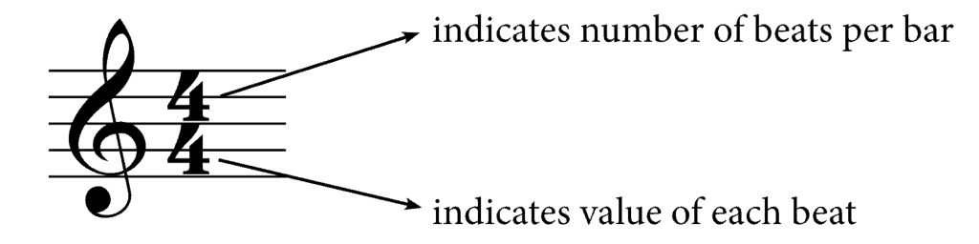
Score writing rules
In a score, we don't only have the notes, but how they are going to be organized between them, and it is in the end a very mathematical organization, we can compare them to fractions.The score will be divided into measures, each of which will be defined by the number of beats that determine it. This beat is determined by the time signature found at the beginning of the score. For example the time signature below would represent a 4/4 time signature
Our Program had to take into account the time signature before putting the notes into each measure. The program has to fill each measure with the right sized note.

Slide 7
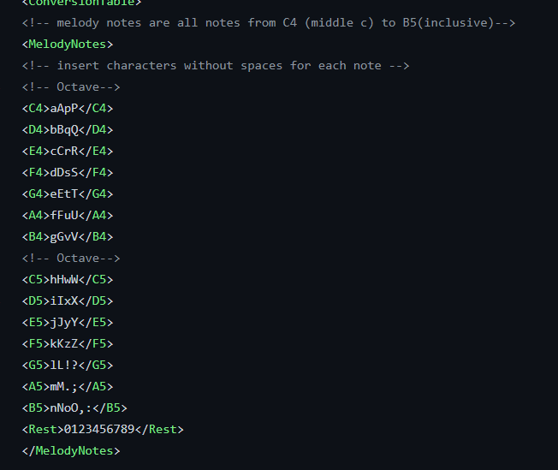
Encoding Table
7
With the way our program is designed, this allows us to freely interchange our XML file to change the encoding of our characters. This allows our music encoder to be more versatile.
For example if we wanted to change what note the letters A-C do we can easily do this by just changing the XML table or uploading an entire new one according to our own encoding rules.

Slide 8
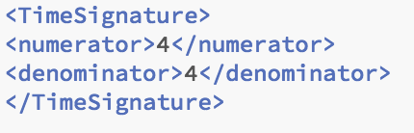
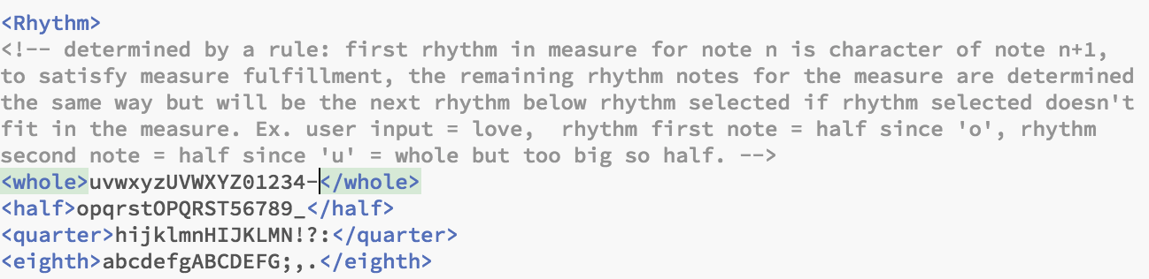
Encoding Table P.2
8
Our XML file also determines the time signature for the music sheet. This allows our music encoder to be more versatile.
Our XML file also determines the rhythm for each note. The rhythm is set much differently from the the type of note (ex. A or C). It is based of the next character of the user input

Slide 9
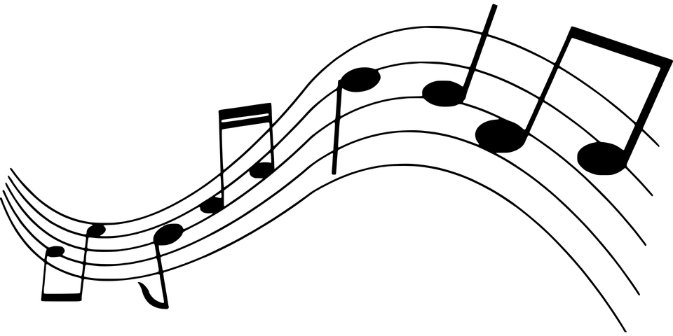
Encoding the music
9
to modify information into and from another representation (be it numerical, electrical, even optical), to serve different uses (like file compression, encryption etc.). In this case were encrypting it into music sheets.
First is to take in a message and assign characters their own unique sound and music Note
We do this by allowing the user to enter a message into our UI.

Slide 10
Decoding
10
We load in the information, taken from user inputted music sheet, into the program, then set all the variables, and display the music within the JScrollpane with the sentence displayed above.
This will happen through the "Load Music Sheet" button. The loaded music sheet’s corresponding message will be displayed in the message box

Slide 11
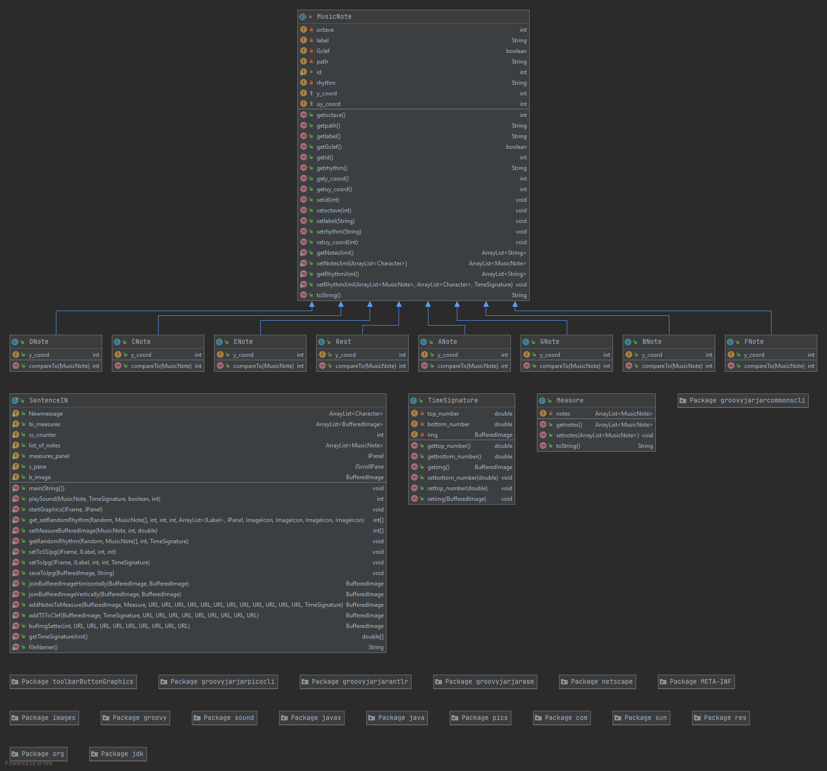
UML Diagram
11

Slide 12
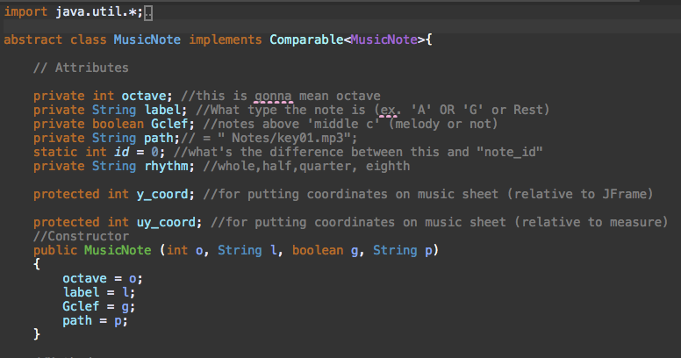
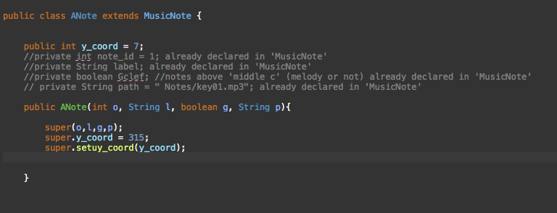
Classes
MusicNote
Rest/ANote and etc.
*Only partial image of class*
12

Slide 13
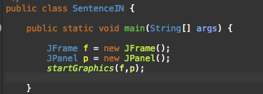
Classes P.2
SentenceIN
Contains most methods
Contains main function
*Only partial image of class*
TimeSignature
13

Slide 14
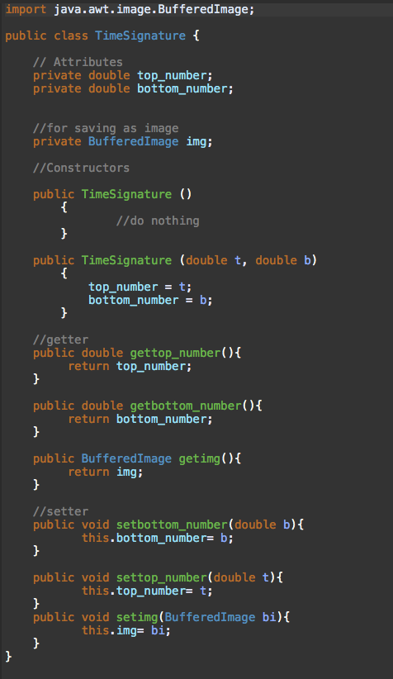
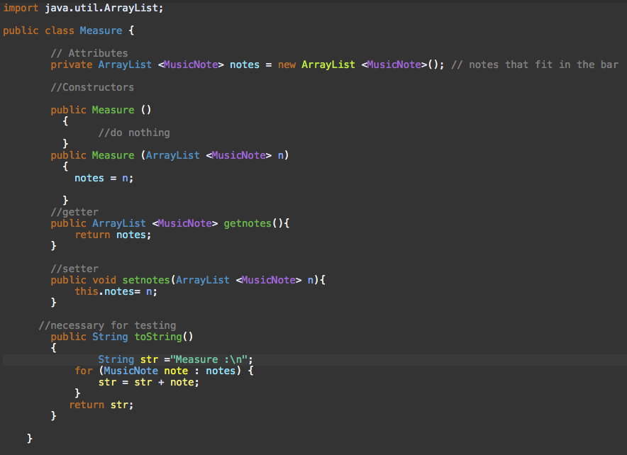
Classes P.3
Time Signature
Measure
TimeSignature
14

Slide 15
Implementations
15
Play music
On play button click (button is only visible after music sheet is have been generated)
A loop of that lasts the count of notes iterations and calls the Playsound method
Playsound gets sound file associated with note and plays duration determined by ts and the note’s rhythm
Display music notes
Music notes displayed on the music sheet dynamically through user input, a textbox (JTextField)
Create instance of notes(ex. A4) from xml
Set rhythm (depends on time signature and room left in a measure)
Proper spacing (depends on time signature)
Note orientation (if C5 or above, upside down)
Set correct location on music sheet (ex. F4 is the bottom space)
Displayed on buffered image for each measure
Buffered images are turned into jpanel and displayed on a Jpanel within a JScrollpane
.

Slide 16
Implementations P.2
16
Note spacing
Get time signature from xml file(Changing time signature changes determines spacing)
Each rhythm note takes up a set amount of space multiplied by a variable determined by time signature
This has the notes properly/evenly occupy each measure
Syncing Automatic Scrolling
On play button click (button is only visible after music sheet is have been generated)
A loop of that lasts the count of notes iterations and calls the Playsound method
Within the loop there’s a condition where once a measure has been played, set rectangle to x value over 1 measure length and call scrollRectToVisible() starting after second passed measure. This moves the content within the JScrollpane over.);

Slide 17
Implementations P.3
17
Backwards Compatibility/Loading Music Sheet
On load button click
Use JFileChooser to select which file to load (only accept “.png” files/files created by program)
Perform same algorithm as when displaying music notes
Results in the application state of when a music sheet was generated (music sheet loaded in JScrollPane and etc.)
Milestones Remaining:
Save Music Sheet
On save button click (button only works after music sheet is have been generated)
Create an array of BufferedImages of all measures from music sheet create
Join the BufferedImages to form 1 bufferedImage in groups of phrases.
Use JFileChooser to select where to save file(get file path)
Use ImageIO.write to save BufferedImage of music sheet to png

Slide 18
Speed bumps
18
Displaying Music Sheet
The music sheet displayed in the JScrollpane was initially displayed by using JLabels on a JPanel for each component (empty music sheet and each individual note). This solution worked for early development, but for inputs that exceeded the viewpoint of the JScrollpane, it didn’t work. We had to change to drawing graphics (notes) onto a buffered image for each measure. Then adding each measure as a JLabel to the JPanel.
Saving to image
Originally, this method would get the dimensions of the JScrollpane viewport and take a screenshot. We had to change this for when the music sheet exceeds the viewport. We ended up combining the measures BufferedImages together in phrases.

Slide 19
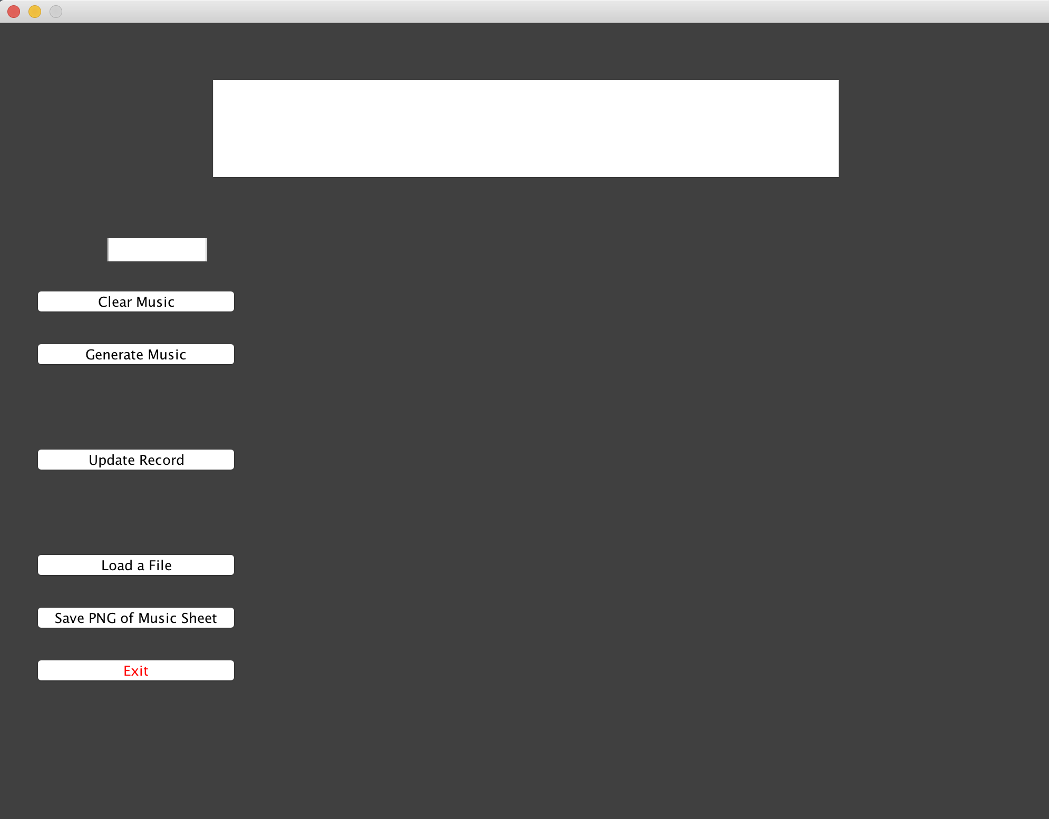
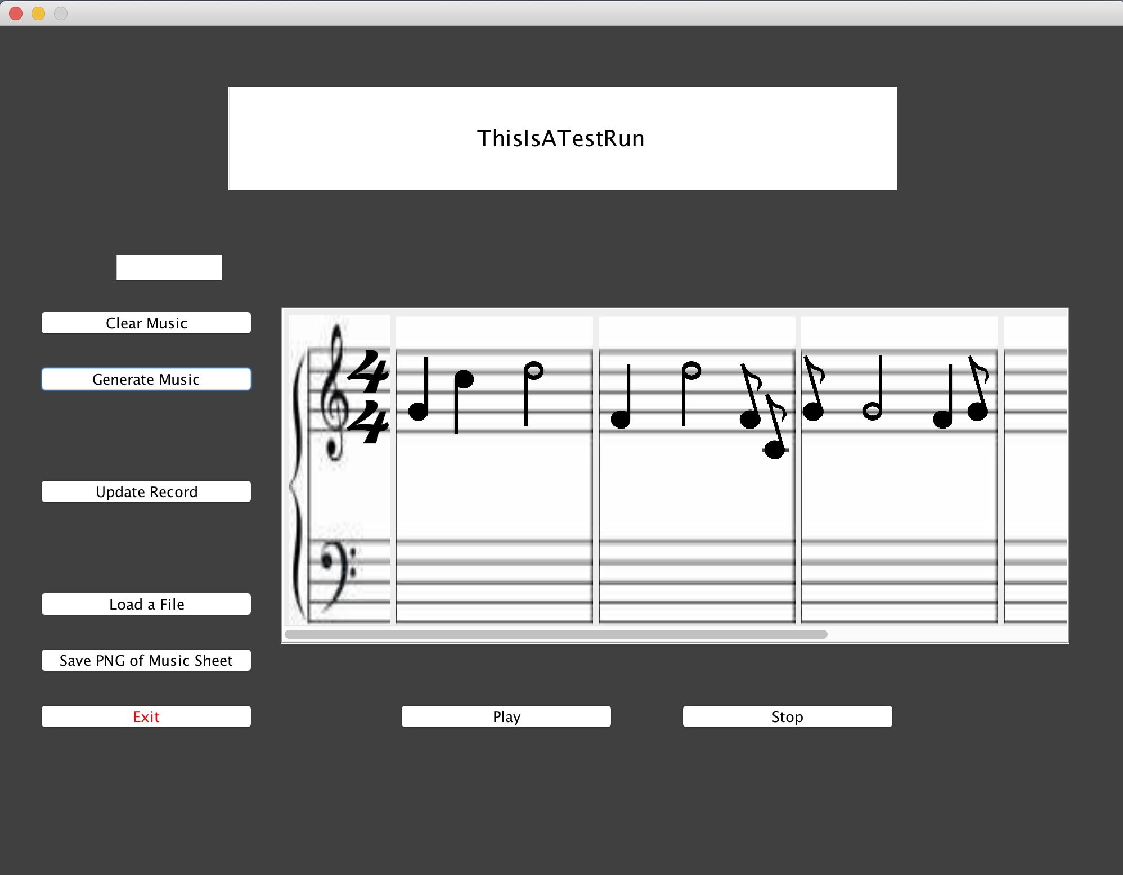
Programs UI
19
As you can see our program lets us input any sort of sentence that we want and this will generate a PNG file that we can then use to play the music and save to our local machine.

Slide 20
Demo
20

Slide 21
Next Steps
21
Have the music produced sound similar to the meaning of the input/sentence. (Ex. Input: “I just won the lottery” Music: sound happy and excited)
Solution:
-Derive meaning(wordlists, semantics)
-Define music scales in xml (Currently, the program only uses 1 scale (C major))
-Set notes to each char given a music scale determined through derived meaning
-Change octave of notes upon intensity of meaning
Currently, the program only uses 1 scale (C major)
2) Enhance overall appearance of the applicaiton
3)Create joined notes for eighth notes where applicable

Slide 22
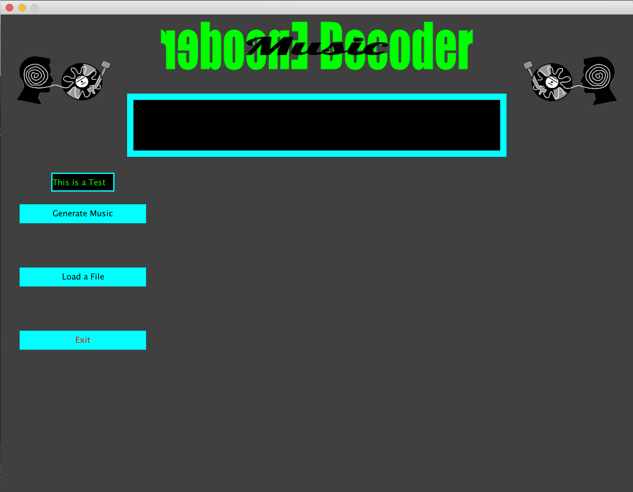
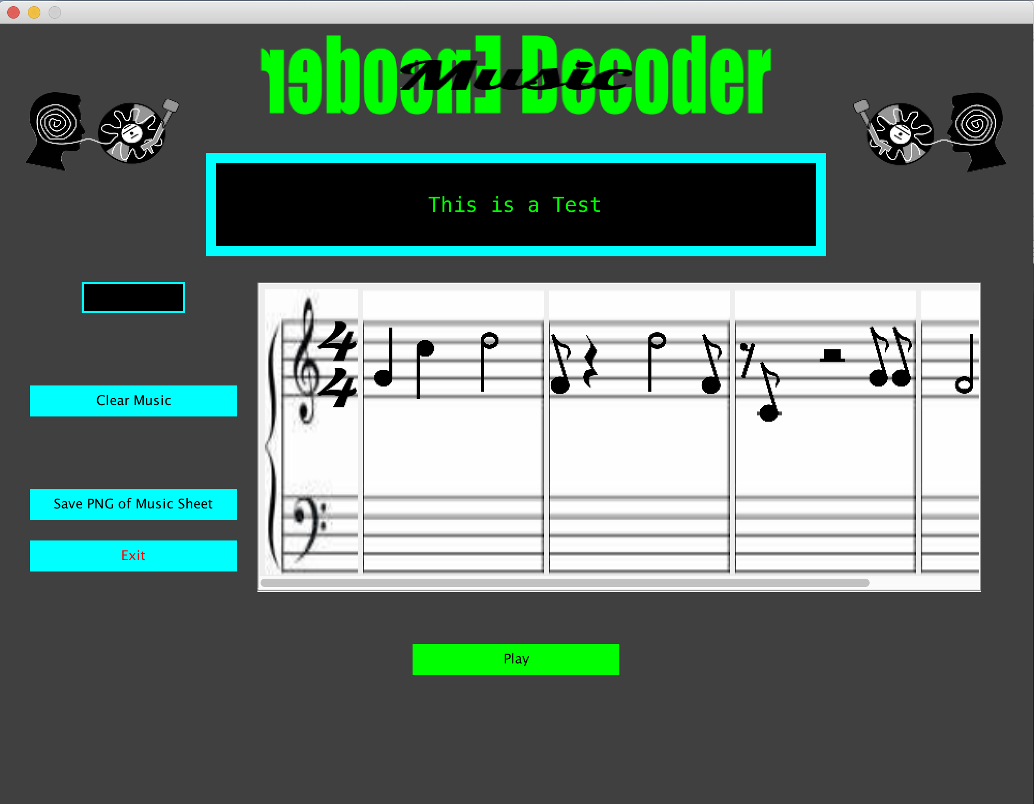
Updated/Current UI
Before clicking “Generate Music” Button
After clicking “Generate Music” Button

Slide 23
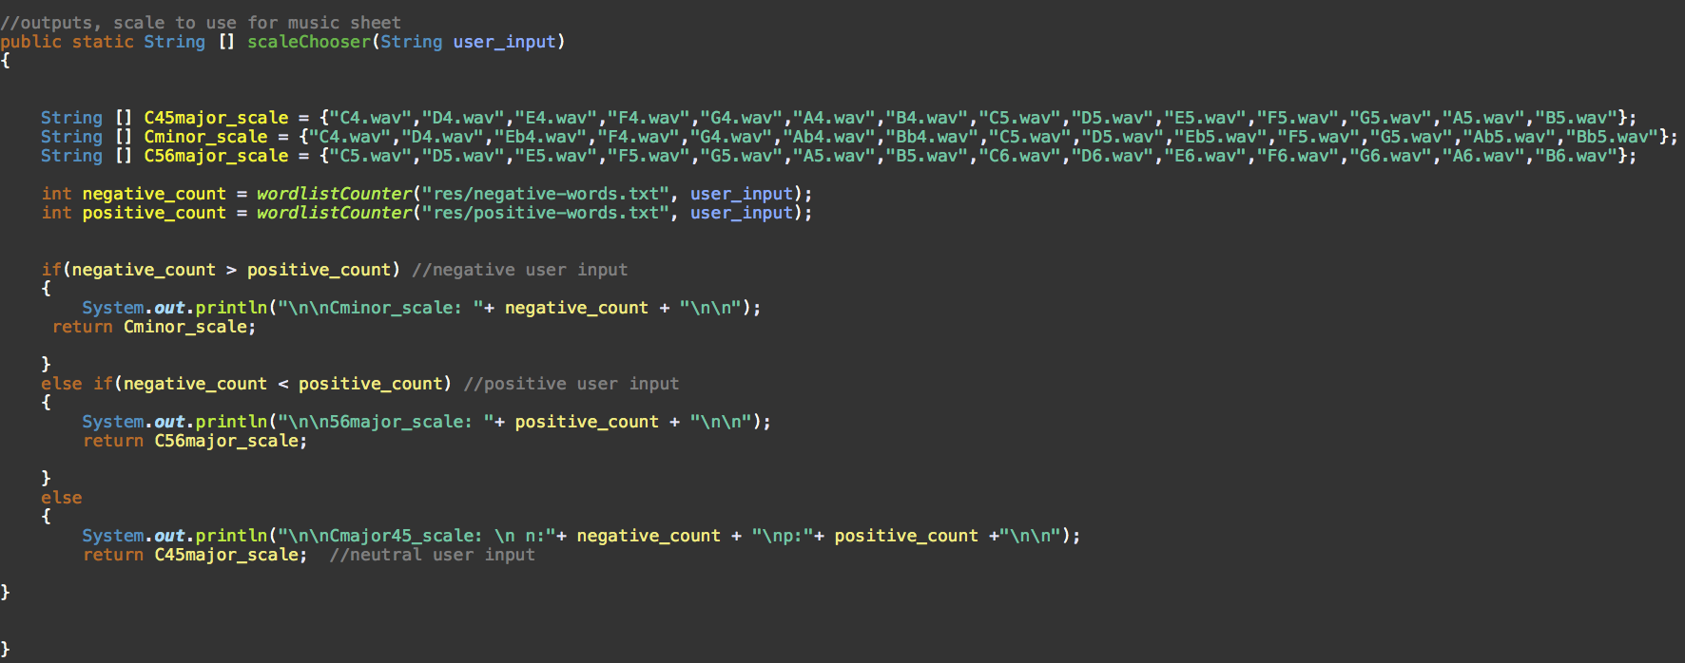
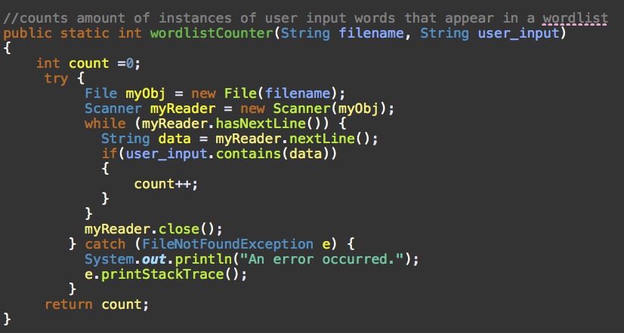
Updated Features
Application derives meaning from user input by counting frequency of words from user input in specific wordlists (positive words and negative words). If neutral result, neutral scale & octave, if positive result, happy scale and higher octave, and if negative result, sad scale and lower octave.

Slide 24
22
Thank you for listening!
Questions?
GitHub: https://github.com/youngtiller/Music-encoder-decoder

